Slide 1

Modelling Disc Winds in Quasars Implications for Unification and Accretion Physics
James Matthews
Christian Knigge, Nick Higginbottom, Knox Long,
Stuart Sim, Sam Mangham, Daniel Proga
SPI-MAX

Slide 2
Outline
Motivation & Review
Why do disc winds matter?
Unification and universality
Methods: Radiative Transfer and Photoionization
Results from a Quasar Model
EW Distributions and the Implications for Unification
Feel free to interrupt / ask for clarifications ☺

Slide 3
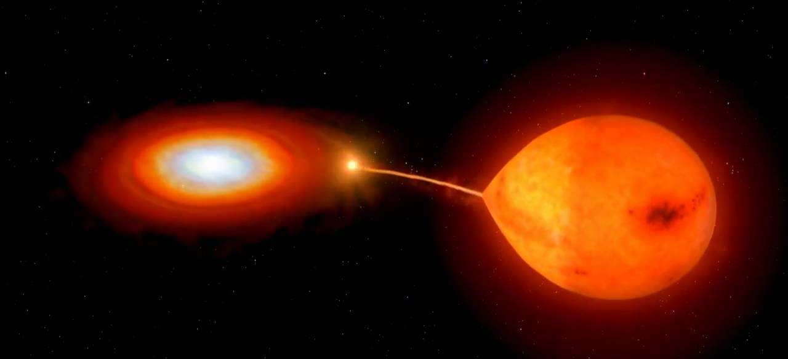
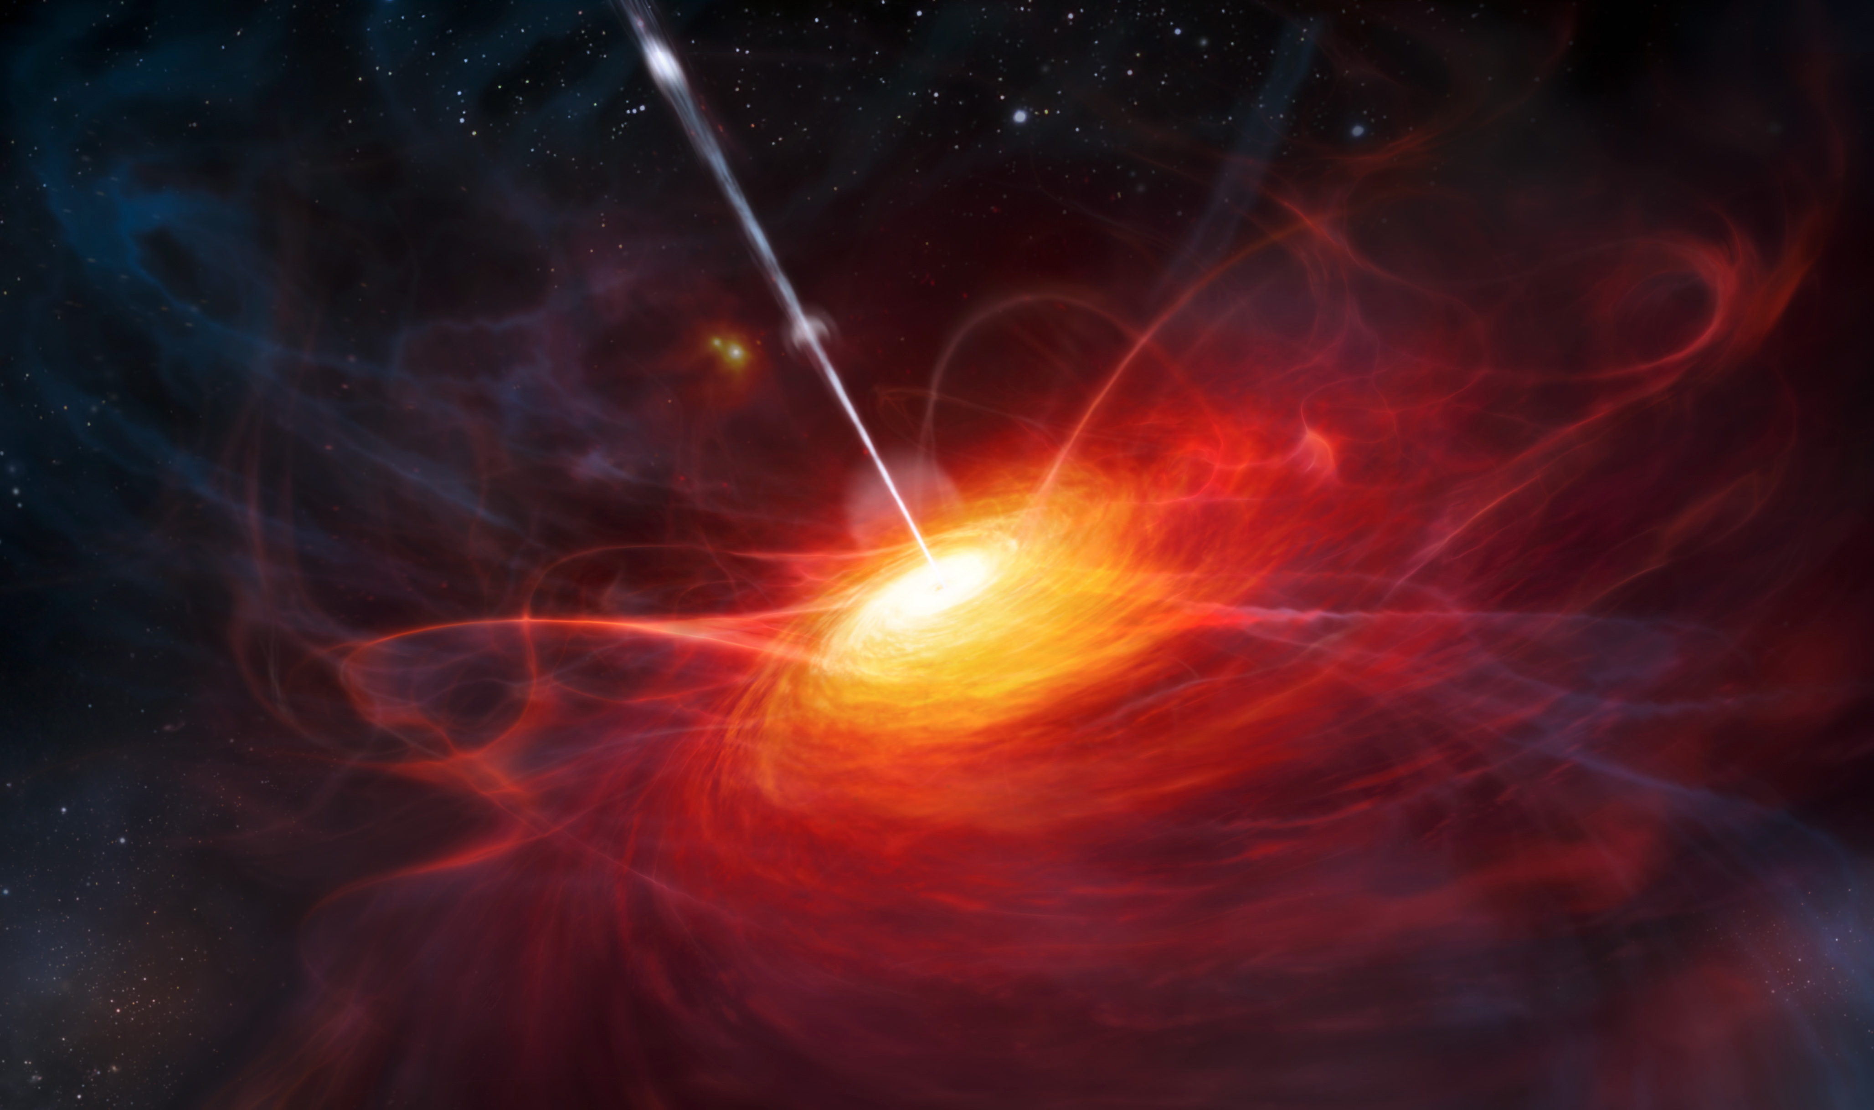
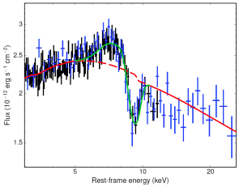
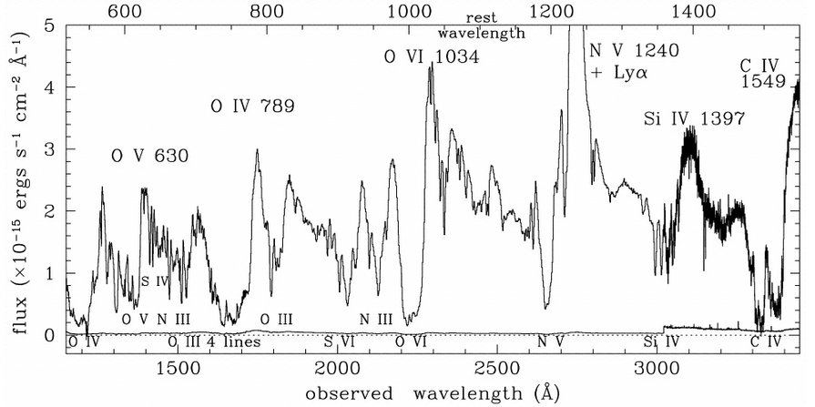
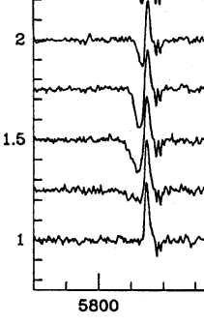
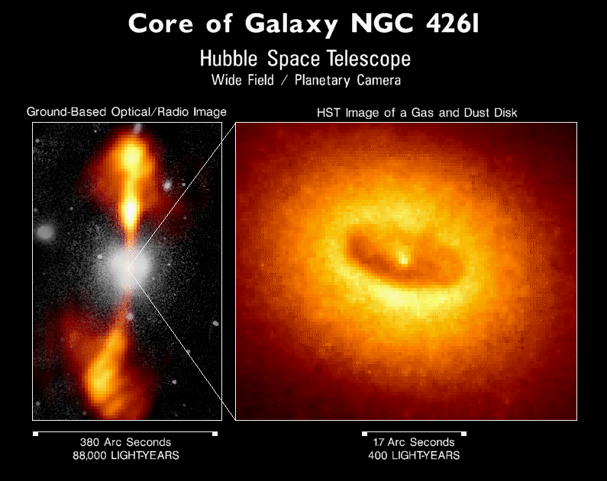
Disc Winds are Ubiquitous
Mass range
10¹⁰
~10⁶ ⁻ ⁹
1
Wavelength range
X-rays: XRBs, AGN
Visible: CVs, XRBs? AGN?
UV: CVs, XRBs, AGN
IR: YSOs, Dust in AGN?

Slide 4
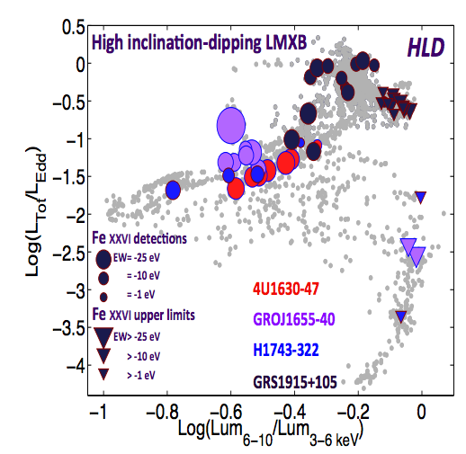
Intrinsic to Accretion?
Winds only appear in soft-state in XRBs…
“Disc-wind-jet connection”
~10⁶ ⁻ ⁹
Ponti+ 2012

Slide 5
BALQSOs
~20% of the QSO population (Knigge+ 2008, Allen+2011)
(depending on selection effects – we’ll come back to this!)
Blue-shifted Broad Absorption Line QSOs
Smoking gun for outflowing material -> disc winds
Potentially ‘line-driven’
PG+0946, Arav 2000

Slide 6
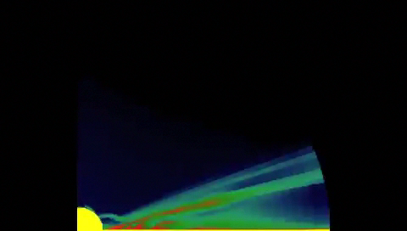
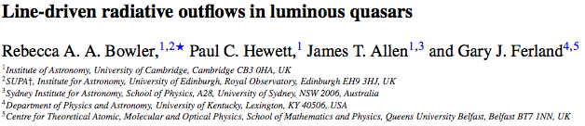
Line-Driven Winds
Radiation pressure on resonance lines – promising driving mechanism
Line-driven winds are unstable
Universal physics
Stellar winds – definitely
CV winds – probably
AGN winds – at least some
Proga+ 2000, 2004

Slide 7
Geometric Unification
Unified models for AGN are widely applied
(Antonucci & Miller 1985, Urry & Padovani 1995)

Slide 8
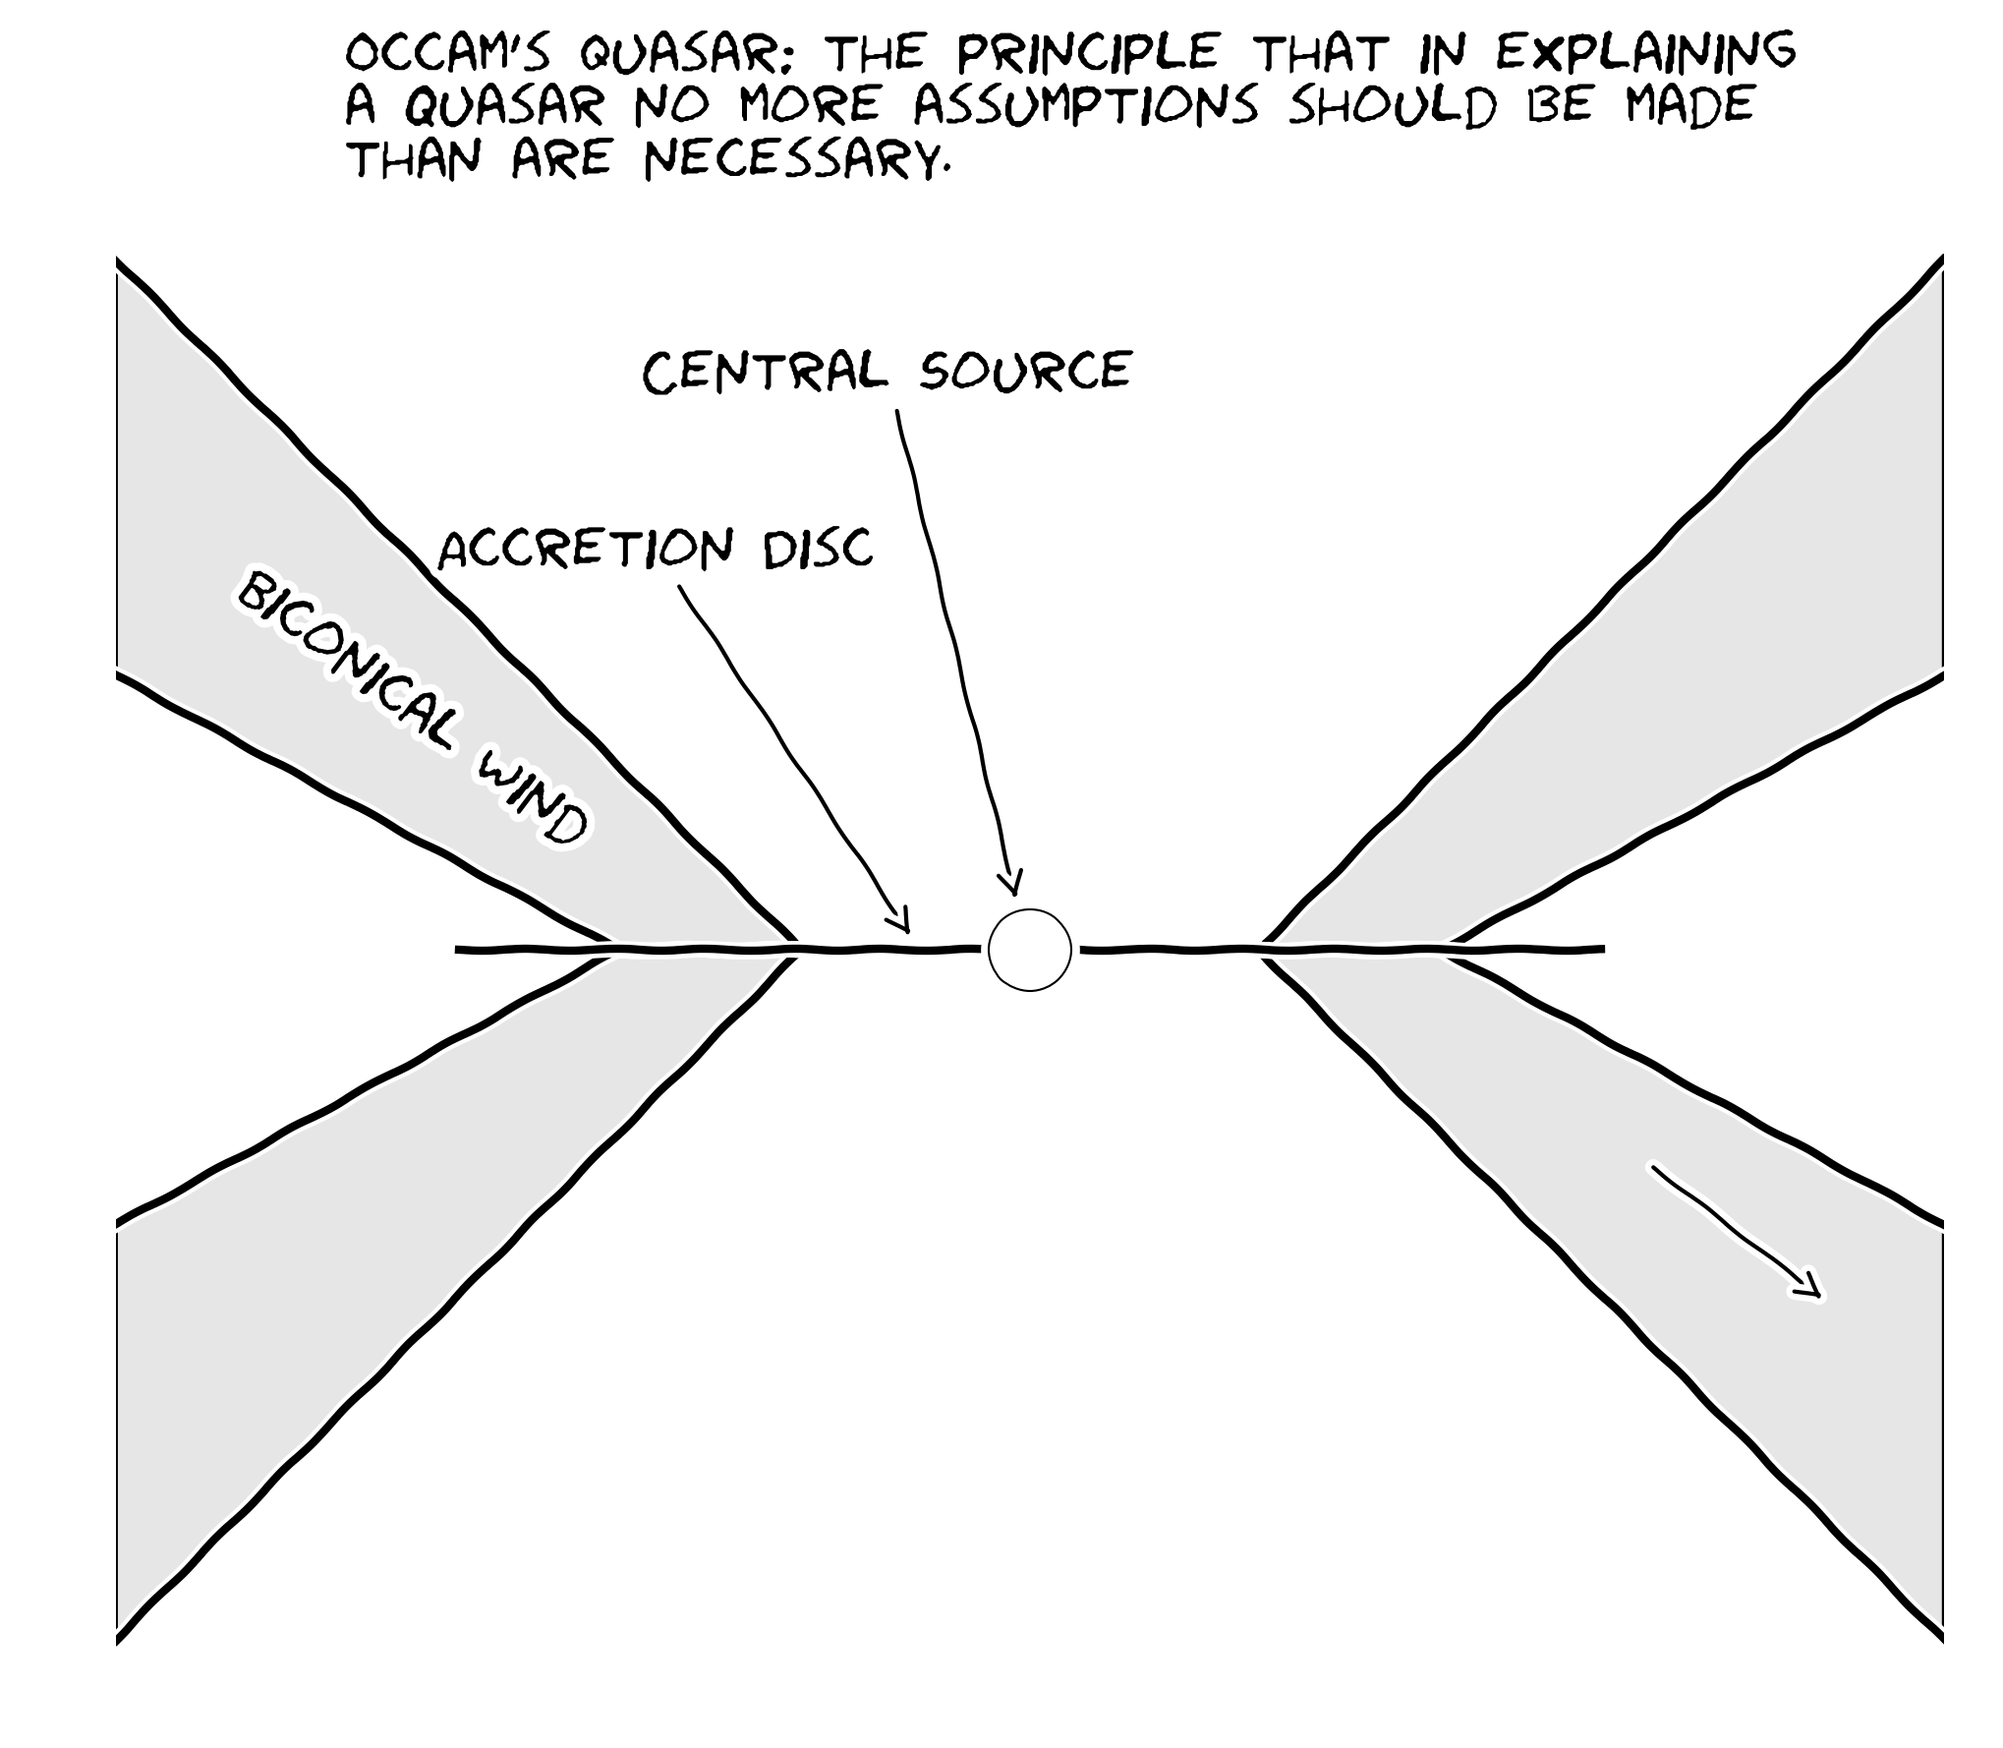
Geometric Unification
Notes:
We adopt a slightly simpler biconical model- probably more physically motivated anyway

Slide 9
My research so far: testing accretion and outflow on all scales…
Unification (e.g. Elvis 2000)
Universality (e.g. Mchardy+ 2006)
Murray & Chiang 1995, Elvis 2000.
Murray & Chiang 1995, Elvis 2000.

Slide 10
Testing The Paradigm
Monte Carlo Radiative Transfer (MCRT)
Global ionization balance
In thermal and ionization equilibrium
(Long & Knigge 2002, Higginbottom+ 2013, Matthews+ 2015, 2016)
Notes:
We adopt a slightly simpler biconical model- probably more physically motivated anyway

Slide 11
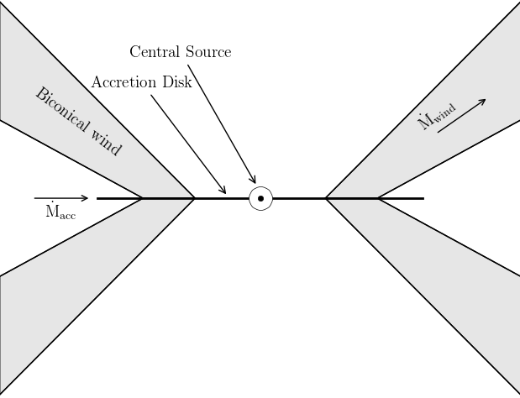

Cylindrical Grid
(x, z, θ)
Track Photons
Photon Sources
Biconical Wind
Notes:
Here’s how our radiative transfer scheme works…

Slide 12
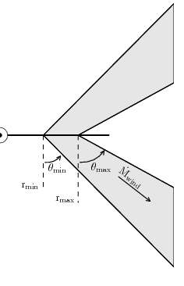
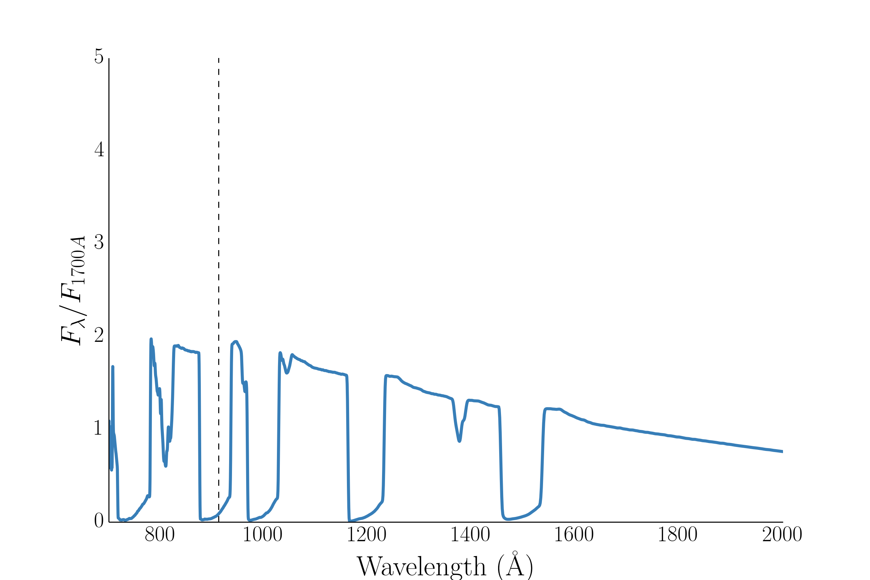
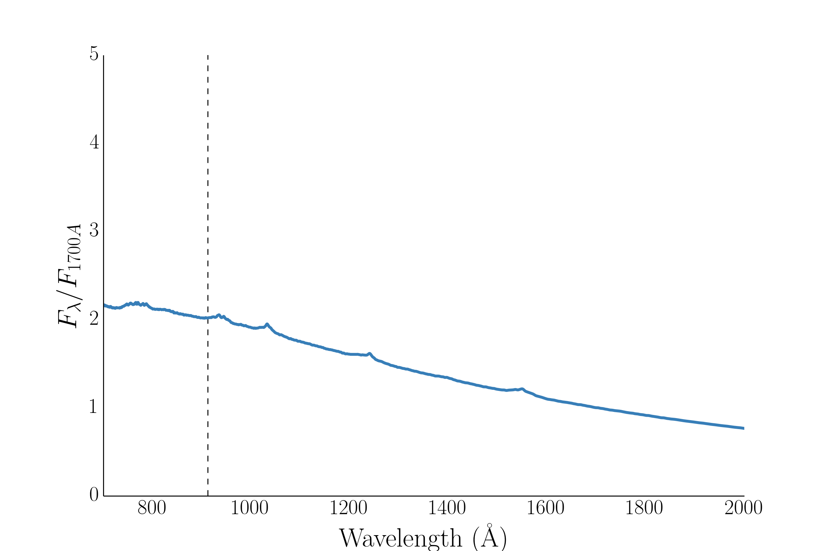
Benchmark BALQSO model Higginbottom+2013 (H13)
Kinematic prescription –
ρ(v, mass loss)
from continuity
Ly α/NV CIV
Ly α/NV CIV

Slide 13
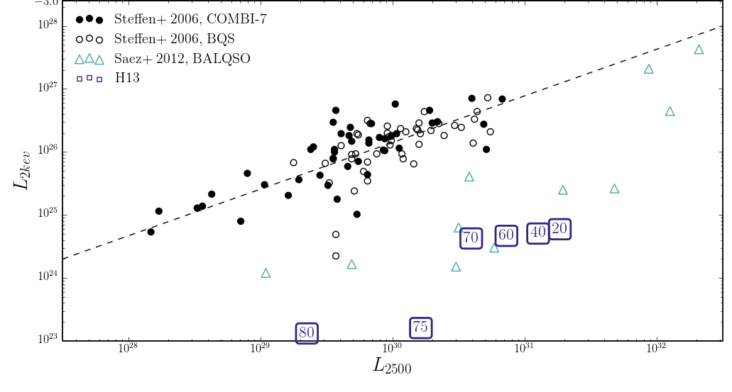
X-ray Properties: H13
‘QSOs’
‘BALQSOs’
Data: Saez+ 2012, Steffen+ 2006

Slide 14
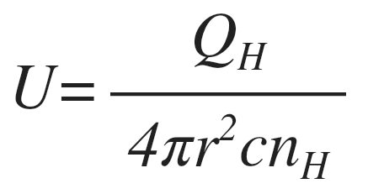
Microclumping
Borrow a stellar winds technique: Microclumping
Optically thin clumps i.e.
Introduce a fill factor f, which produces a density enhancement D
‘Density squared’ processes enhanced
Ionization state moderated for given radiation field
R_{clump} << 1/(σn) (~ 10¹⁴cm w/ Thomson, n_{e} = 10¹⁰)
D=1/f

Slide 15
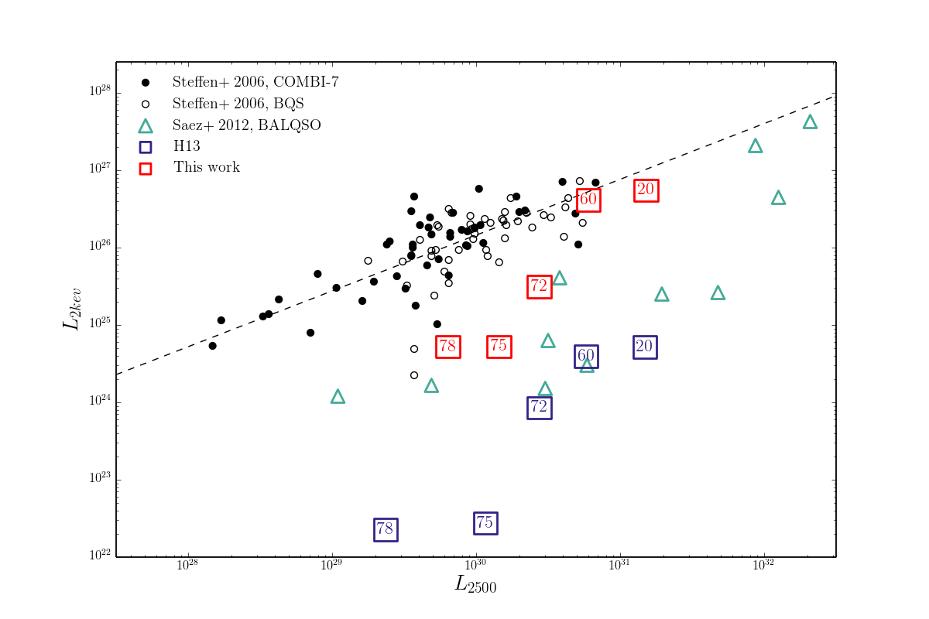
X-ray Properties: Clumpy Model
‘QSOs’
‘BALQSOs’
D = 100 (f = 0.01)
Isotropic X-ray source
Data: Saez+ 2012, Steffen+ 2006

Slide 16
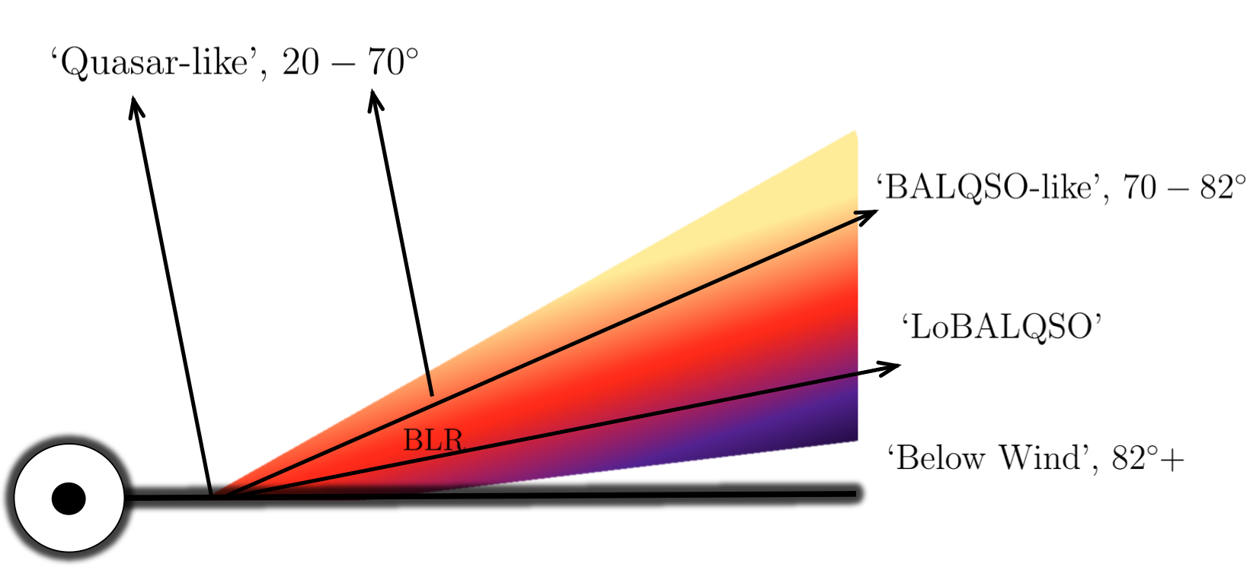
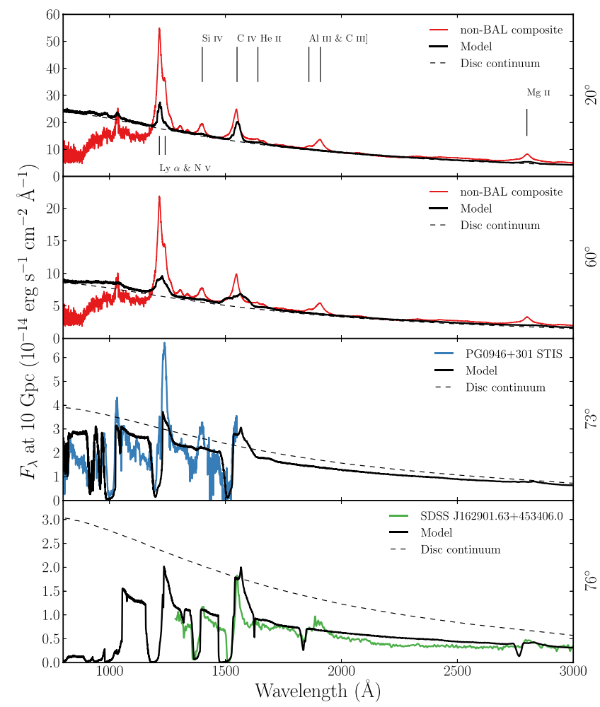
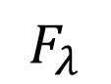
Synthetic Spectra
NV/Ly α
CIV
Si IV
$$F_{λ}$$
Al III
Mg II

Slide 17
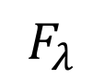
Synthetic Spectra
NV/Ly α
CIV
Si IV
$$F_{λ}$$
Al III
Mg II

Slide 18
Synthetic Spectra
$$F_{λ}$$

Slide 19
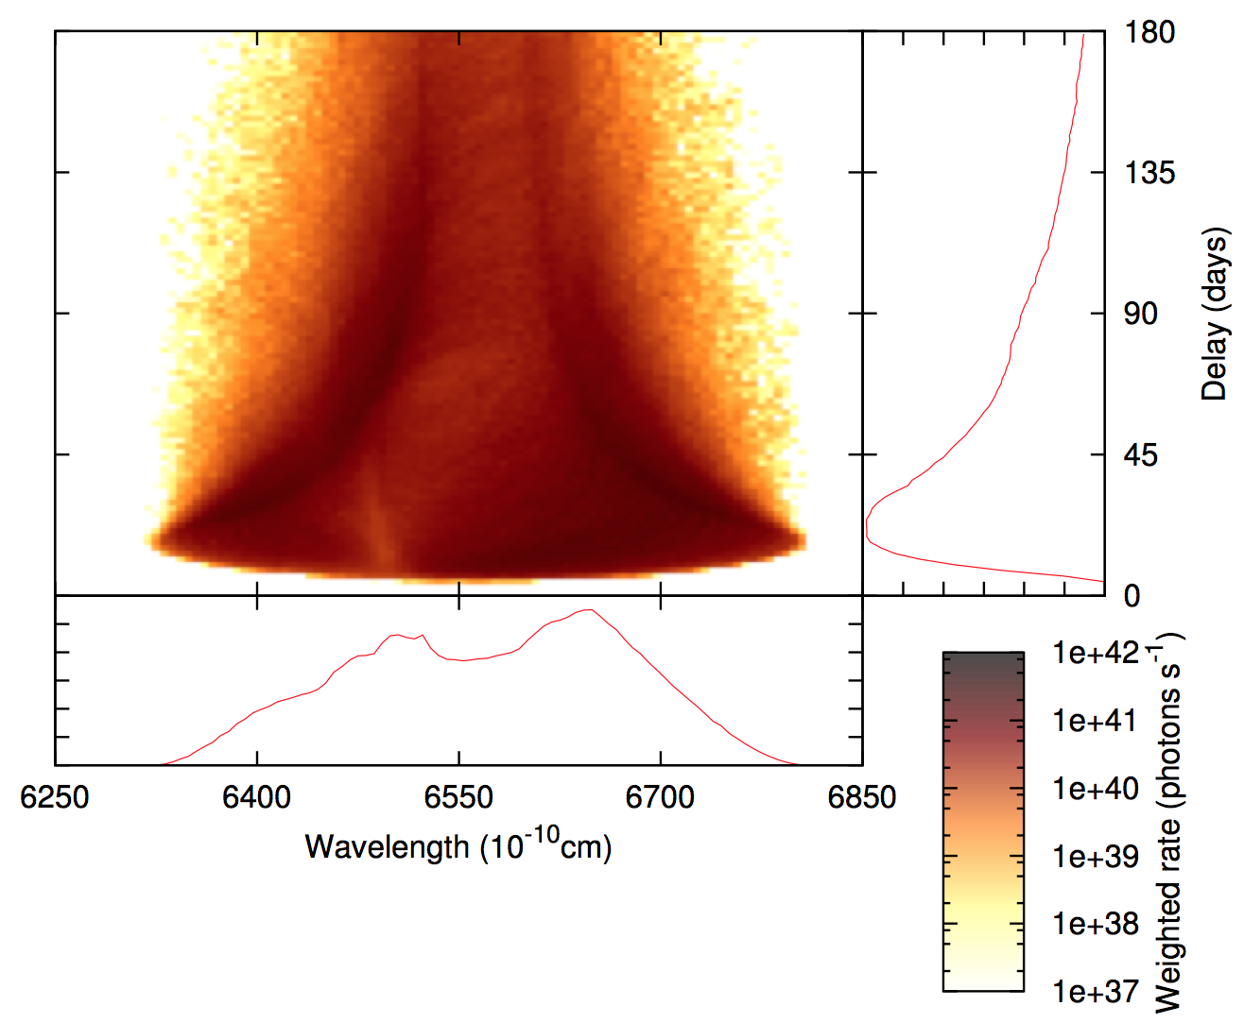
Aside: Line Transfer Functions
Mangham et al. (in prep)

Slide 20
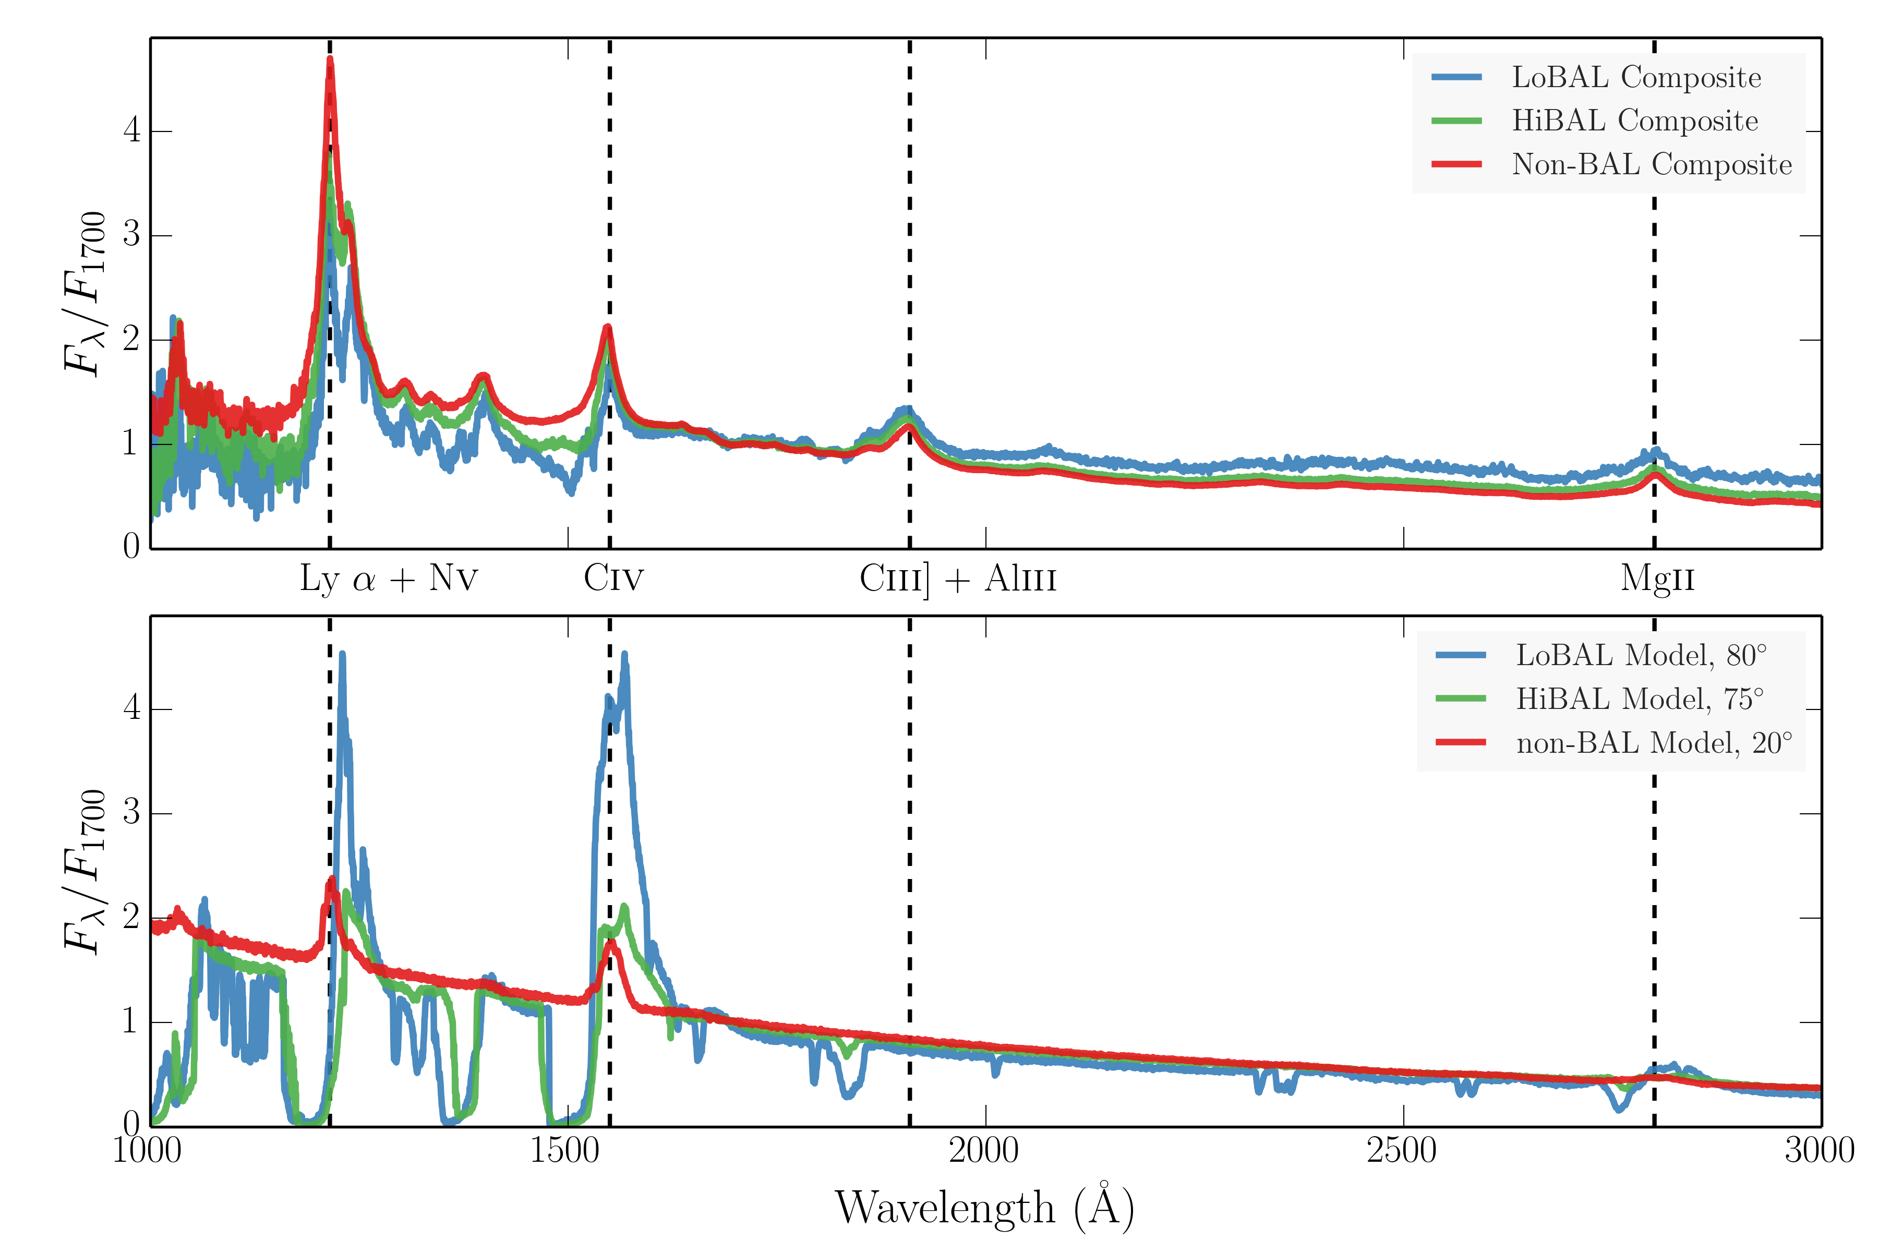
Synthetic Spectra
Quasars and BALQSOs have remarkably similar emission line properties (Weymann et al. 1991, Reichard et al. 2003).
Our models don’t.

Slide 21
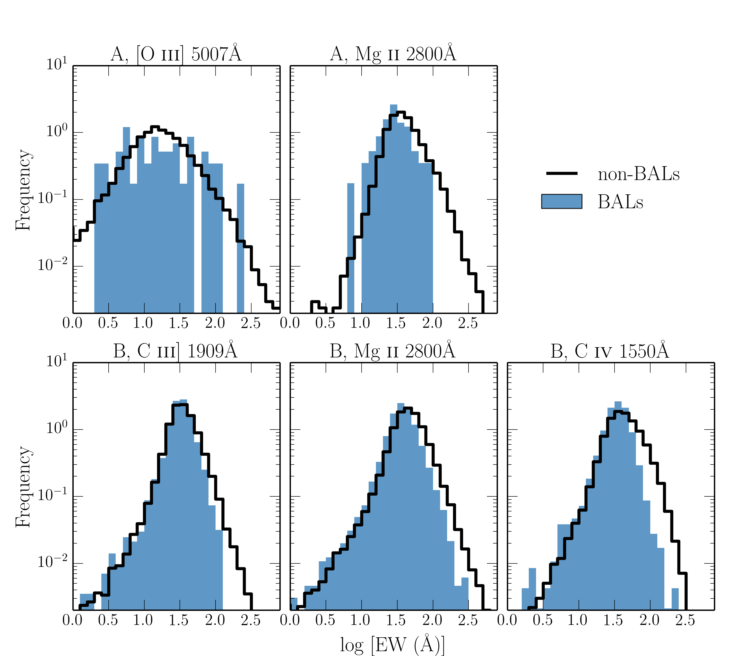
Observed EW Distributions

Slide 22
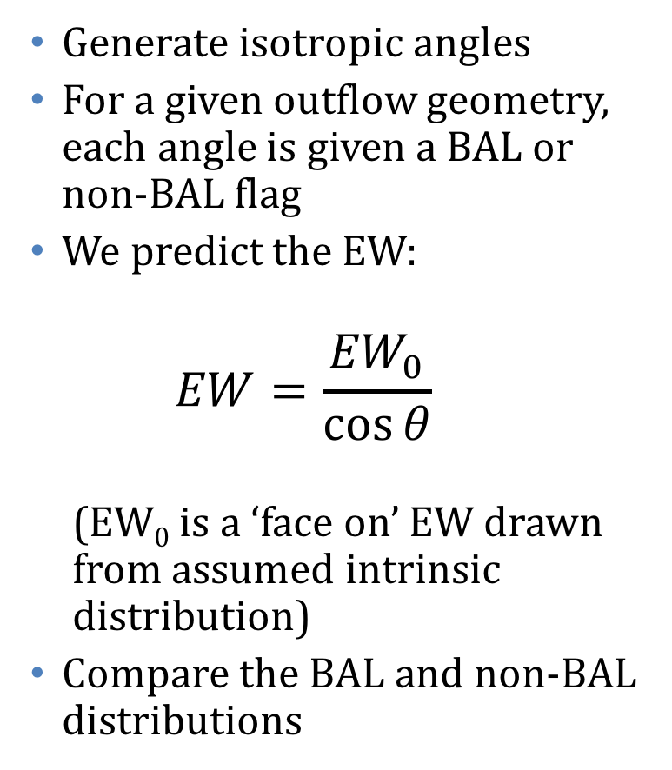
Toy geometric model
Generate isotropic angles
For a given outflow geometry, each angle is given a BAL or non-BAL flag
We predict the EW:
$$EW=\frac{{EW}_{0}}{\cos{θ}}$$
(EW₀ is a ‘face on’ EW drawn from assumed intrinsic distribution)
Compare the BAL and non-BAL distributions

Slide 23
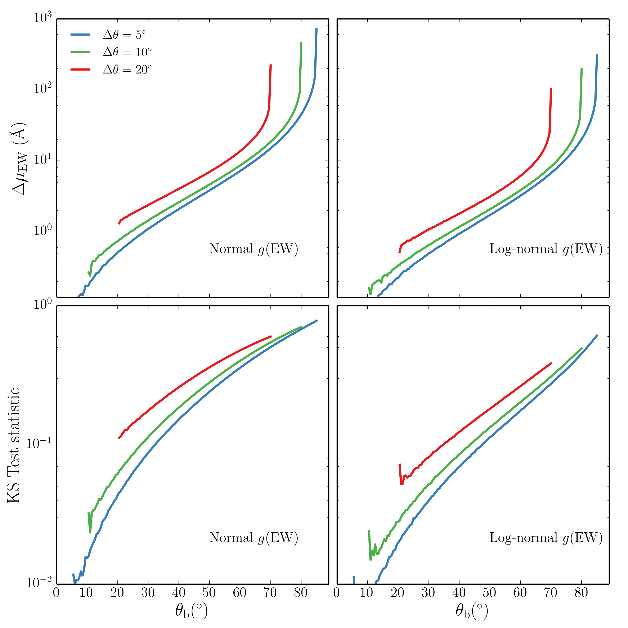
Predicted EW Distributions

Slide 24
It is difficult to reproduce uniform line properties in quasars and BAL quasars unless the continuum and lines have the same angular distribution of emission.
(Matthews+in prep)
Not unique to wind models for the BLR!
Possible solutions:
A: BAL outflows are not equatorial
B: The disc doesn’t emit like a disc
C: The line emitting region emits anisotropically in the same way as the disc
not expected from theory of line emission from a Keplerian disc
(Horne & Marsh 1985, Murray & Chiang 1996) or from forbidden lines.
D: Geometric unification doesn’t work.
BAL outflows still need to have a geometry!

Slide 25
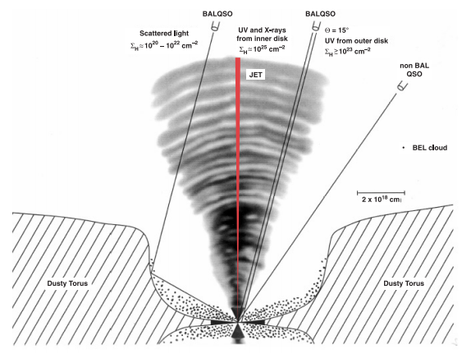
Scenario A: BAL outflows are not equatorial
Evidence:
No obvious preferred region in Eigenvector I parameter space
Clear evidence for at least some “polar” BALQSOs (Zhou+. 2006, Ghosh & Punsly 2007)
Notes:
Summarise results

Slide 26
Scenario A: BAL outflows are not equatorial
Conflicts:
Line-driven models produce equatorial flows (Murray & Chiang 1995, Proga+2000, 2004)
Polarisation studies have favoured equatorial geometries (Goodrich & Miller 1995, Lamy & Hutsemekers 2004; Brotherton+ 2006)
But see also Smith+ 2004…perhaps ~40 degrees is permitted?
Goodrich & Miller 1995
Notes:
Summarise results

Slide 27
Scenario B: The disc doesn’t emit like a disc…
Evidence:
There are multiple problems when confronting disc theory with quasar observations anyway
disc-size problem, e.g. Morgan+ 2010, Edelson+ 2015.
1000A break e.g. Lusso+ 2015.
review: Koratkar & Blaes 2009, Antonucci 2015.
Beyond BALs: Can measuring orientations distinguish between current disc and BLR theories?
Notes:
Summarise results

Slide 28
What about obscuration?
Obscuration can clearly affect EW if the line emission and continuum emission pass through different columns
Perhaps obscuration dominates the EW[OIII] distribution? (Caccianniga et al. 2011)
Their model: continuum more obscured than [OIII]
In this case, we should again expect high EWs in BALQSO
they almost always have N_{H} > 10²² (Green+ 1996, Gallagher+1999, Morabito+ 2013, Page+ 2016)
BALQSOs tell us that the EW[OIII] distribution can’t be driven by obscuration.
Notes:
Summarise results

Slide 29
Summary
Clumping can moderate the ionization state of an outflow
X-ray properties now agree well with data.
BALQSO winds can produce strong emission lines
Equivalent width distributions challenge geometric unification models (Matthews+ in prep)
Can’t be readily explained by GR, line anisotropy or obscuration
Scenario A: BAL outflows are not equatorial
Scenario B: The disc doesn’t emit like a disc
In both cases, the EW[OIII] distribution is cannot be driven by inclination, as has been suggested (Risaliti+. 2011)
What’s clear: “first-order” models don’t explain quasar phenomenology very well…
Reliable orientation indicators are crucial
Notes:
Summarise results

Slide 30
Additional Slides
Notes:
Summarise results

Slide 31
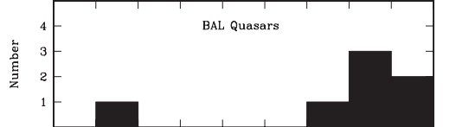
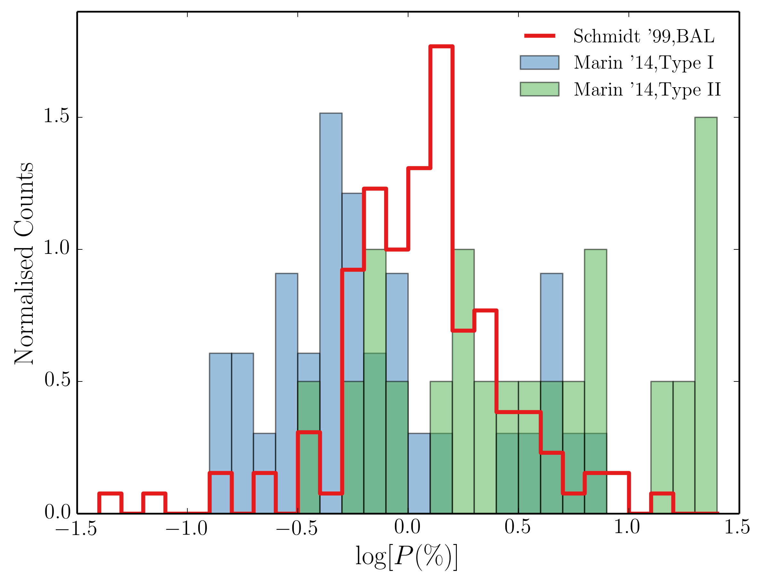

Scenario A: BAL outflows are not equatorial
Brotherton+ 2006
Erratum!
Polarisation angle w.r.t radio axis
$${60}^{ο}$$
More detailed polarisation modelling would help!
Notes:
Summarise results

Slide 32
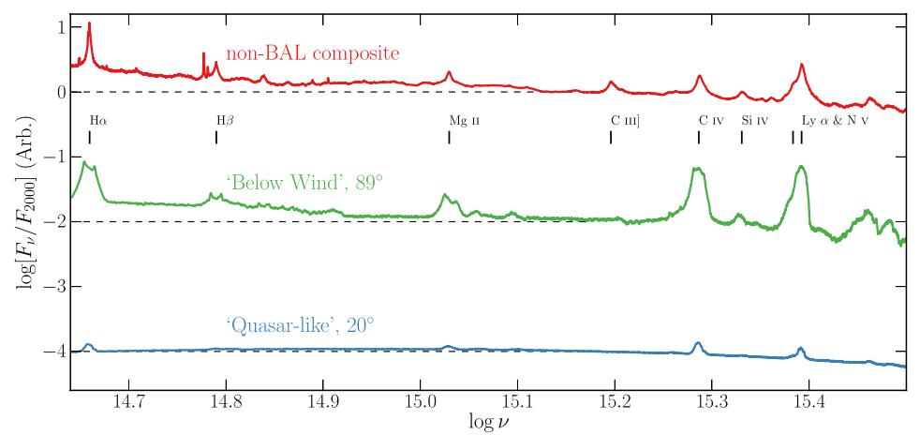
Synthetic Spectra

Slide 33
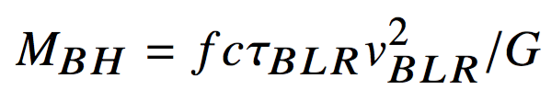
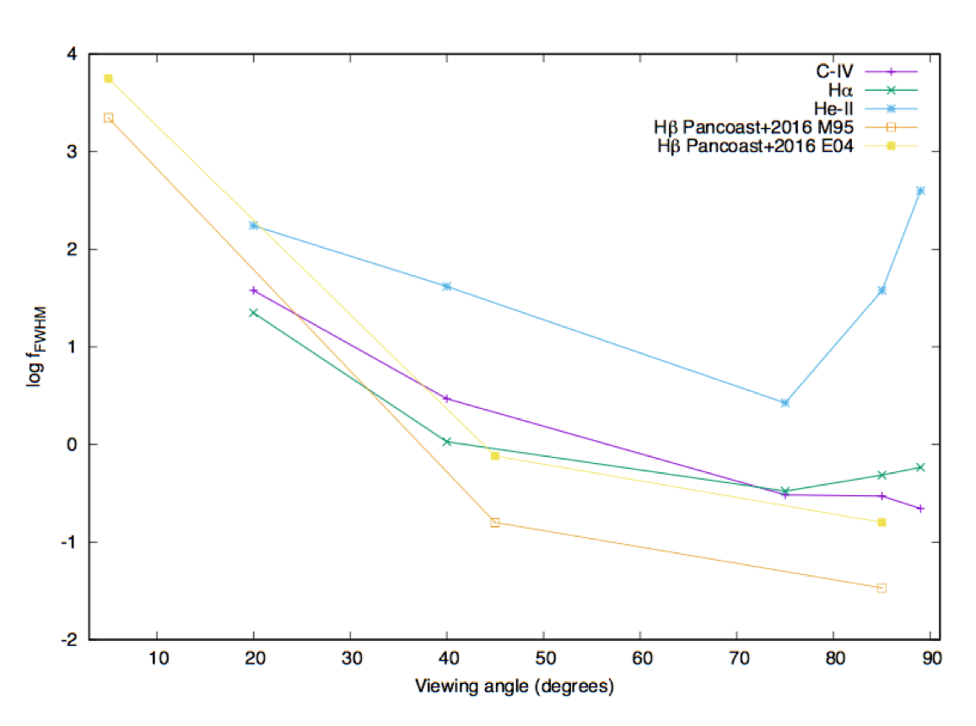
Virial factor

Slide 34
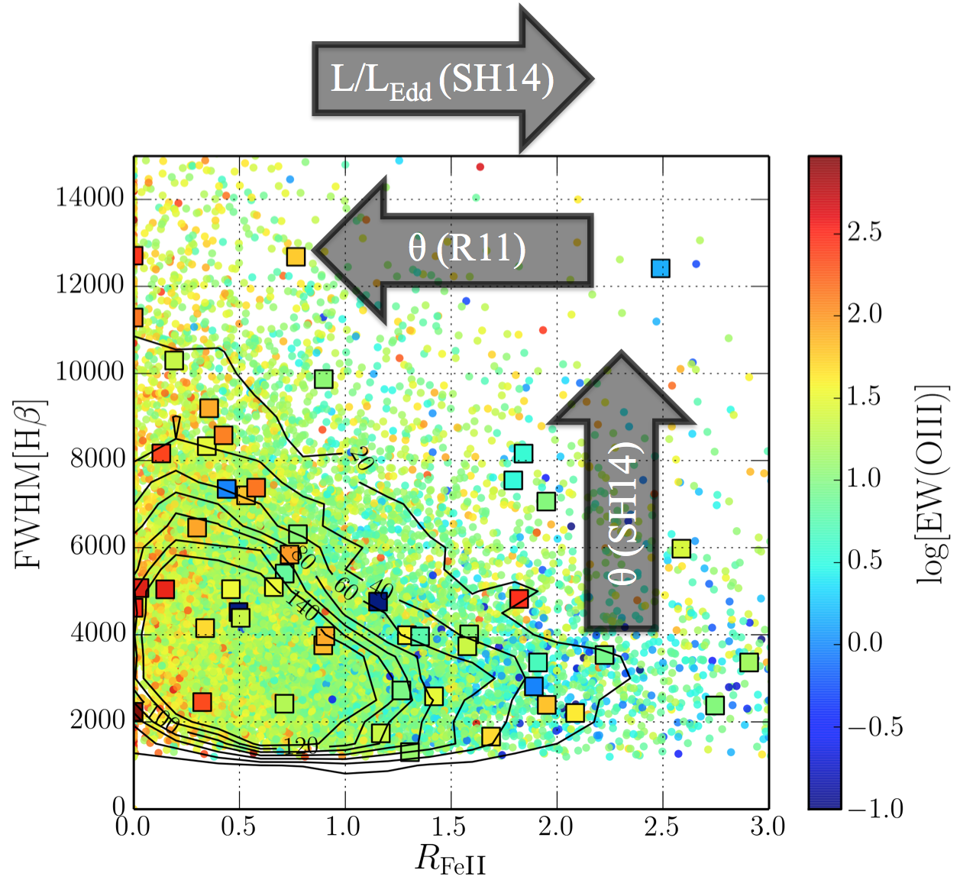
Eigenvector I

Slide 35
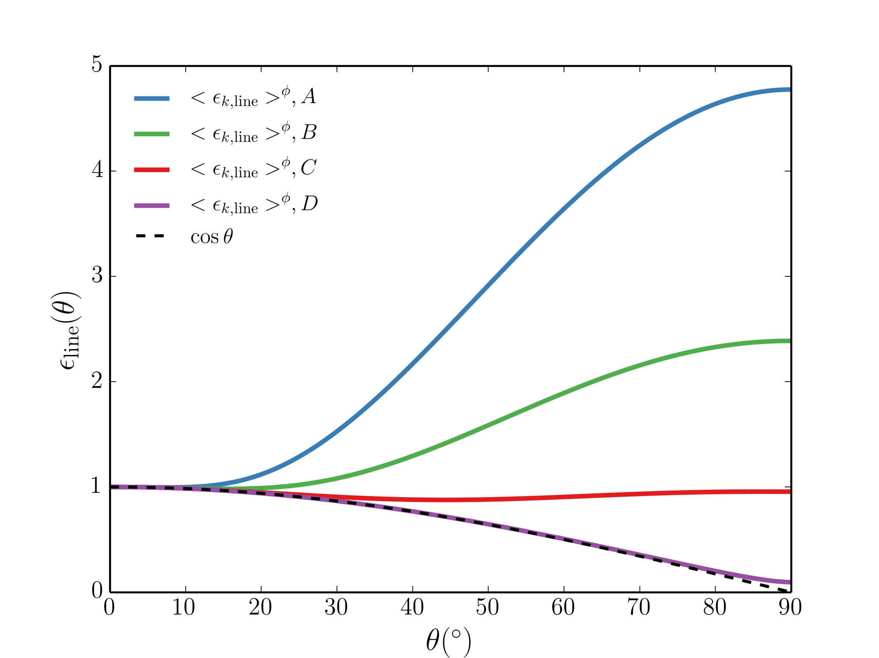
Line Anisotropy
D has H/R = 0.01
Too low for BLR.
Caveat: Ferland, Korista and others have suggested that a series of clouds can emit like cos(theta)
Notes:
Summarise results

Slide 36
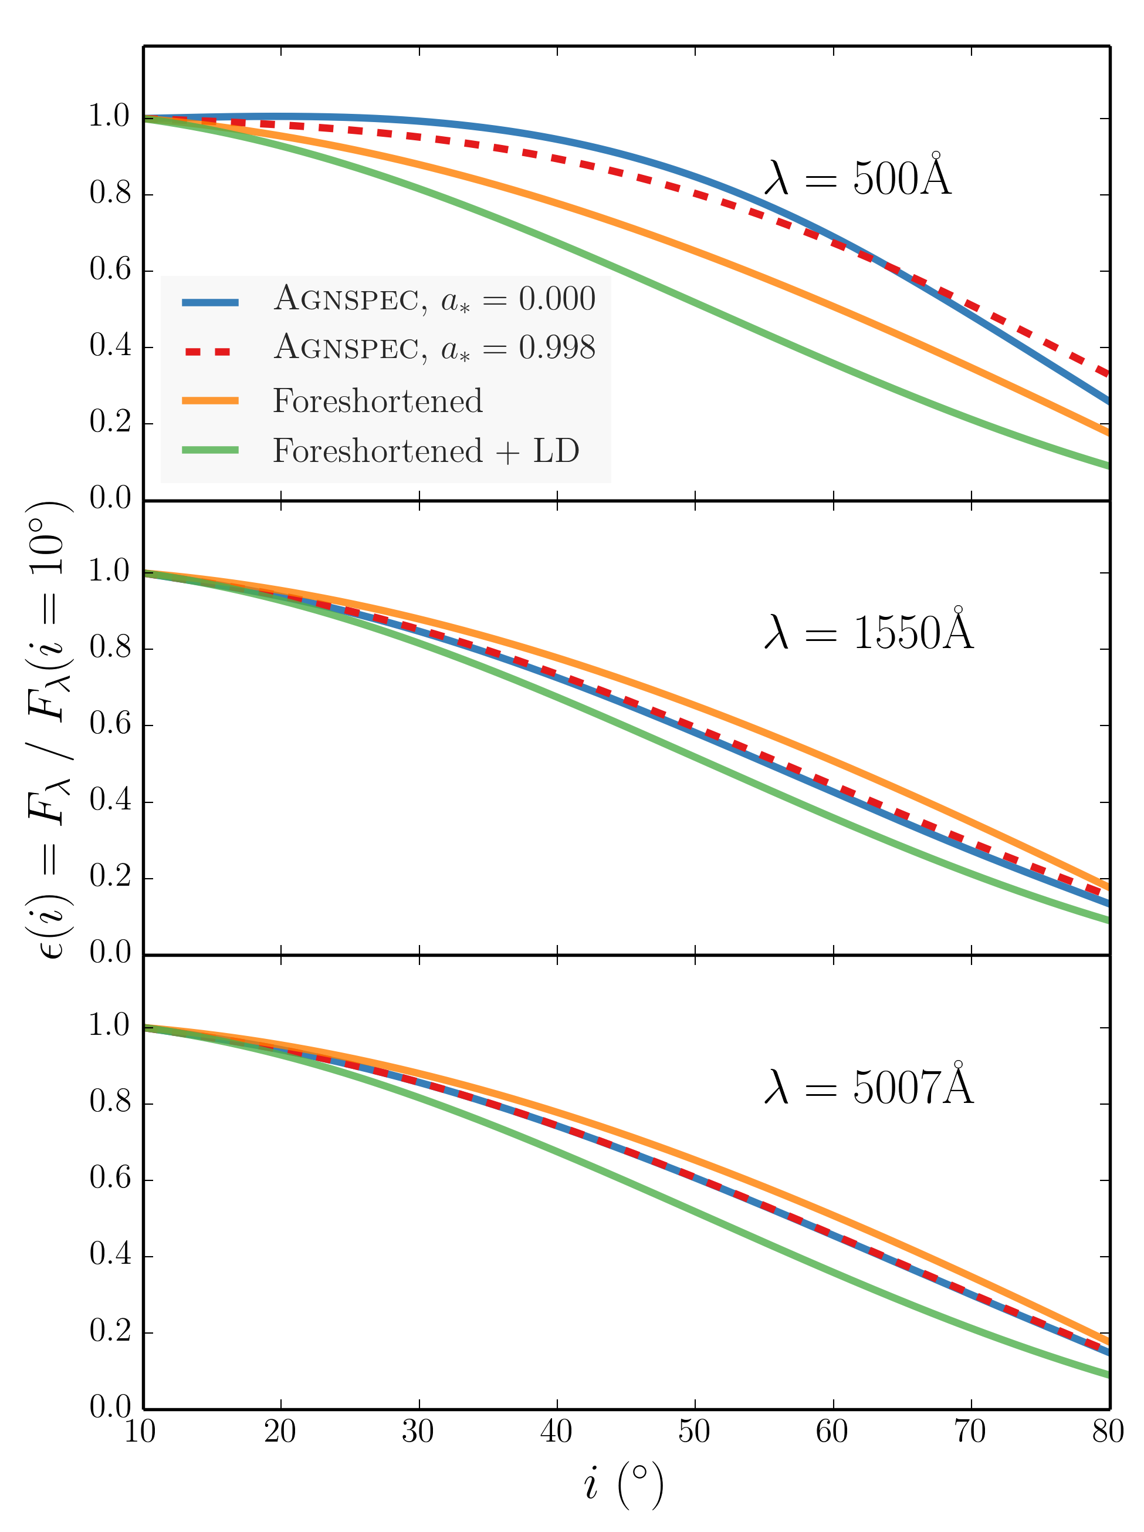
GR Effects
Notes:
Summarise results

